Slide 1
Calendar Share
Group 9

Slide 2
Team Roles
Joseph Hill – Project Manager/Backend
Robert Law – Backend
Barry Latour – Web Frontend
Jacob Haake – Web Frontend and Security
Joel Robertson – Mobile
Miguel Cordero - Mobile

Slide 3
Application Explanation
Event driven platform designed to help users be more engaged in their community
Create or join groups to share events
Add friends and invite them to groups

Slide 4
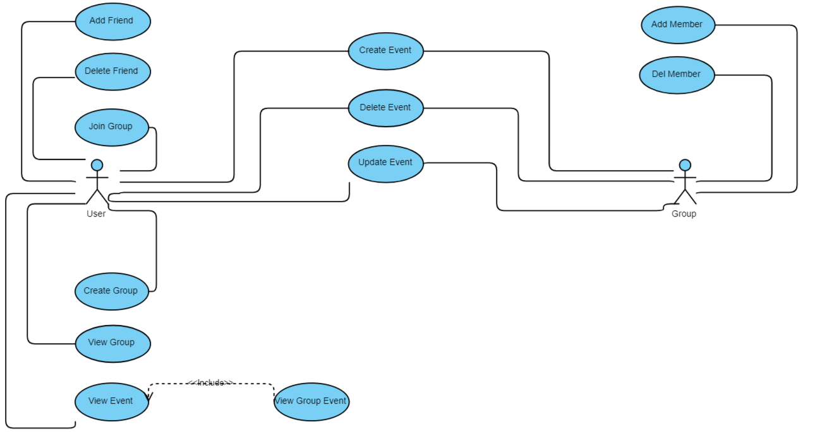
Use Case Diagram

Slide 5
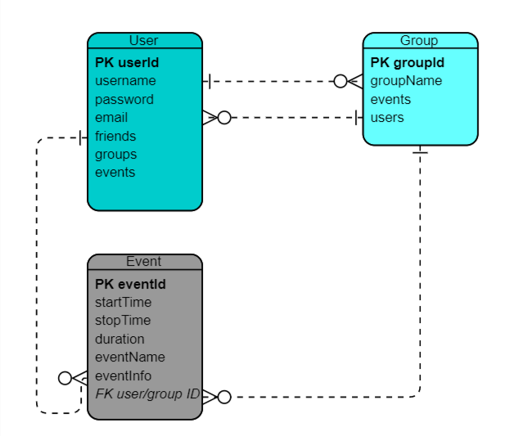
Entity Relationship Diagram

Slide 6
Backend Technology
MongoDB – NoSQL Database
Nodejs – JavaScript runtime
Express – Web framework
Heroku – cloud hosting platform
OAuth – secure access to application data
Postman – API testing

Slide 7

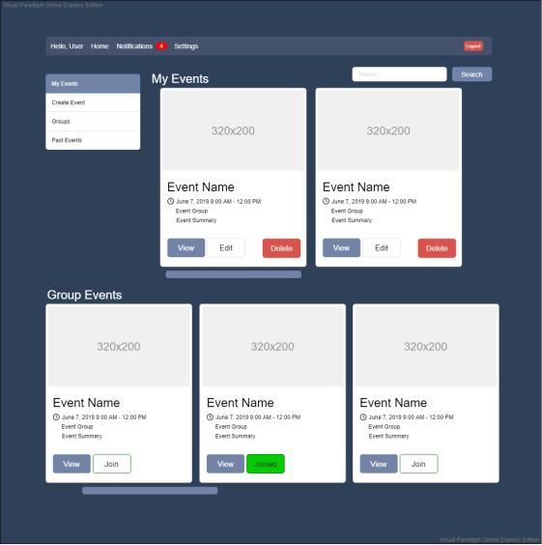
Web Prototype

Slide 8
Web Technology
React – front end framework
mdbootstrap – bootstrap components for React
Bcrypt.js – hash and salt passwords
Axios – https client
Passport.js – authentication with Facebook, Google+ LinkedIn
Mocha.js – JavaScript test framework

Slide 9
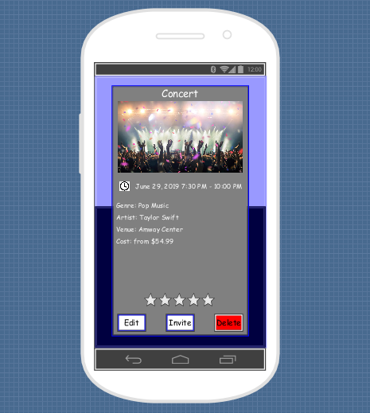
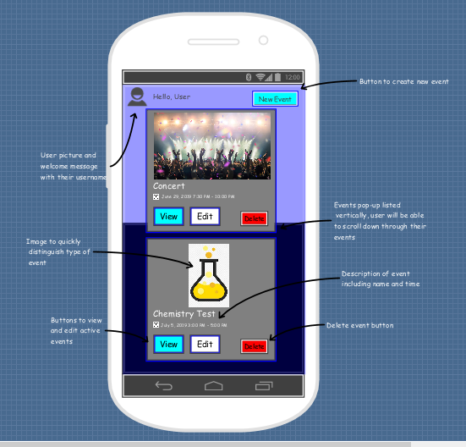
Mobile Prototype

Slide 10


Mobile Technology
Flutter – mobile application framework
Dart – programming language for Flutter
Target Mobile OS - Android

Slide 11
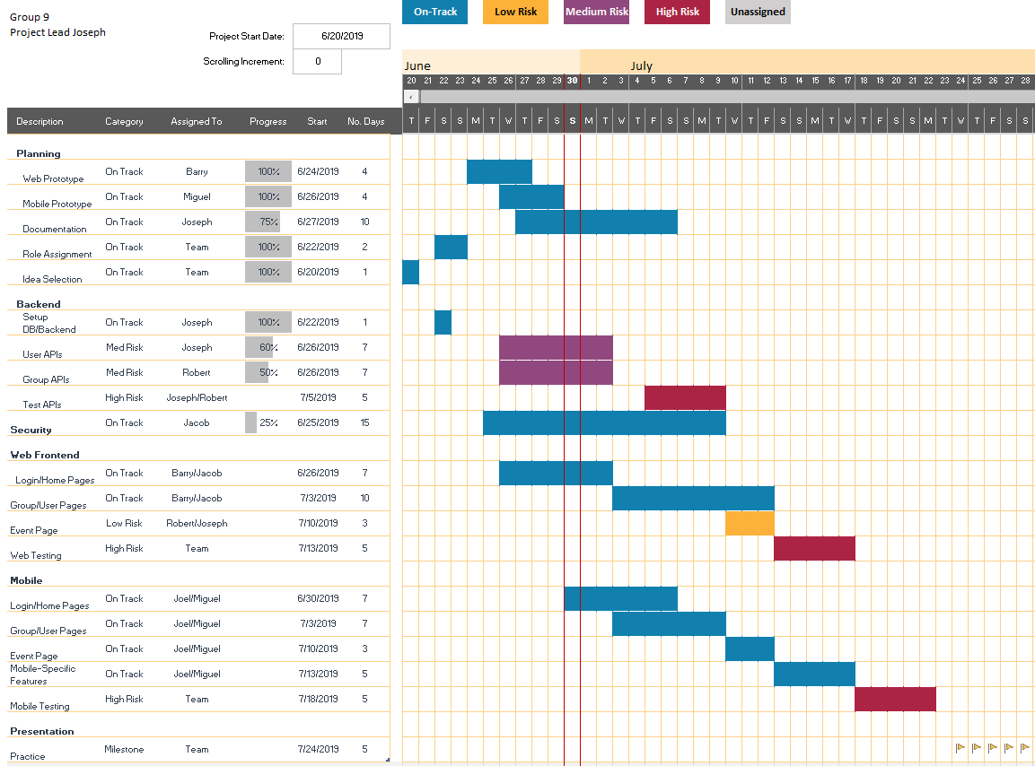

Slide 12
Monetization
Local businesses can promote their events to local users
Advertisements for popular upcoming events
Booking service, event insurance

Slide 13

Questions?

